Slide 1

ZEPTO Analysis

Slide 2
Introduction of ZEPTO
Established in 2021
Founders : Aadit Palicha and Kaivalya Vohra
Head quarters: Mumbai
Zepto's mission is "Quick Commerce" platform
(To provide ultra-fast delivery of groceries and daily essentials )

Slide 3

Business Model Analysis
Zepto’s Revenue
.Product Sales
.Delivery fees
.Advertising
.Higher – margin own
product
Choice Of the Customers
.Fast delivery
.Convenience
. Offers
.Wide product range
. Reliable service

Slide 4
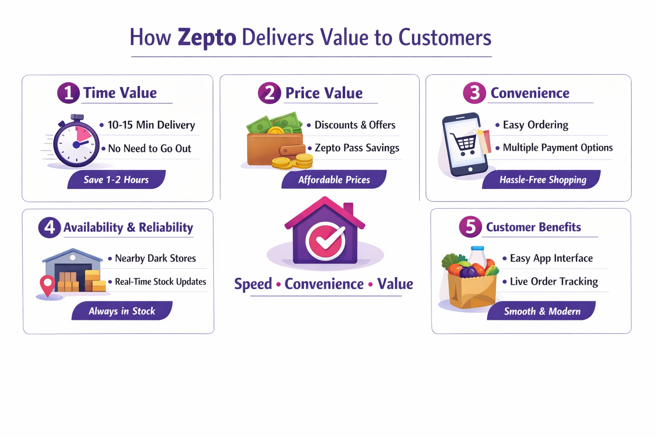
Notes:
Image source: Microsoft 365 content library
Business analysis identifies organizational needs and recommends solutions to drive success. It involves gathering and interpreting data to inform decision-making and optimize processes. Effective business analysis helps reduce risks, improve efficiency, and supports strategic planning, ensuring companies stay competitive in a dynamic marketplace.

Slide 5
Key Differentiators
Uniqueness
Strong Branding
.Unique Brand Colour
.Clear Brand Message
Customer Experience
.Fast & Smooth APP
.Real Time Tracking
.Quality & Packaging
.Personalised offers
⚡ Ultra-fast delivery model
🏪 Dense network of dark stores
📦 High product availability
📱 Simple & quick ordering app
💳 Zepto Pass subscription benefits

Slide 6
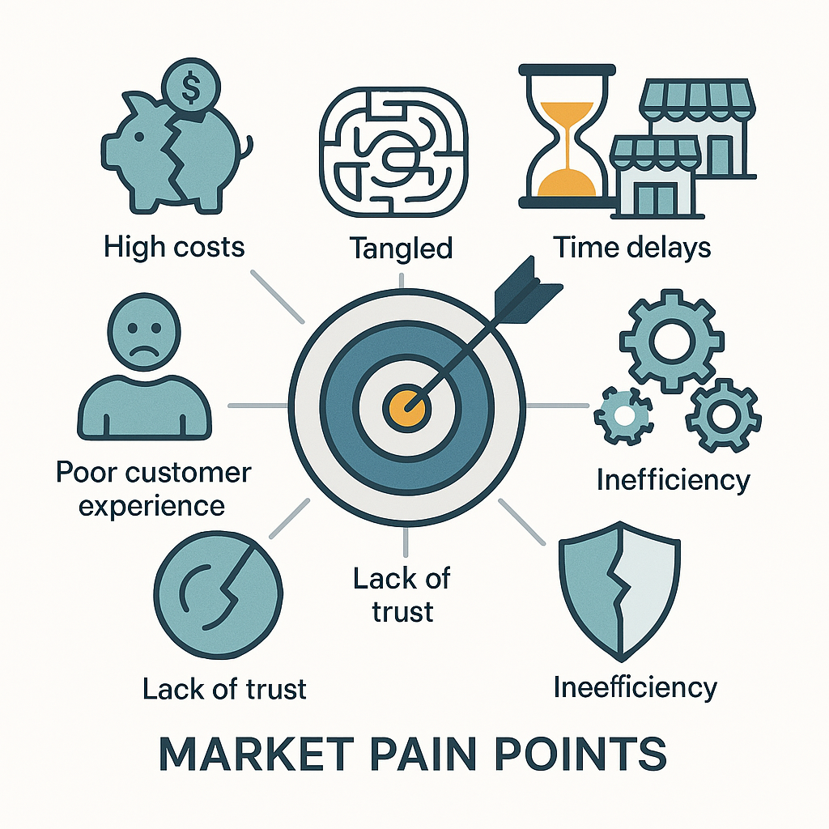
Market Gap & Customer
Need Analysis
How Zepto Solves Market Problems
Quick delivery at door steps
Instant solution for urgent needs
Dark store warehouse model
Real - time tracking
No delivery slot booking
Easy to use mobile APP
Customer Benefits of Zepto
⚡ 10-Minute Delivery 🛒 Order Anytime
⏱️ Emergency Needs 🚀 Saves Time
📦 Reliable Products 📱 Easy App Use
Market Pain Points Before Z
.

Slide 7
Technology & Innovation Study
Technology Impact on Zepto
⭐Quick Deliveries
⭐Accurate Tracking
⭐Efficient Operations with AI
⭐Smooth and Fast Mobile App Experience
Technological Elements
⚡Cloud Computing Infrastructure
⚡AI & Machine Learning
⚡Geolocation Technology
⚡Delivery Routing Algorithms
⚡Data Analytics Dashboards
⚡Dark Store Automation System

Slide 8
⚡ Speed 🏬Warehouse 📱Technology
Dark Stores
Zepto’s
Innovations
Quick Delivery

Slide 9
Fast Delivery
Good Service
User Friendly App
Responsible Delivery Partners
Quality Products
Vegetables are not fresh
No response
Higher Price
No Cancellation policy
Missed Items
NEGATIVE
P
0
S
I
T
I
V
E
Normal Timing not Fast
Ontime delivery but limited variety
Good App But Out of stock
NEUTRAL
CUSTOMERS REVIEW
Good service but nothing special
Items are fine but price is high

Slide 10
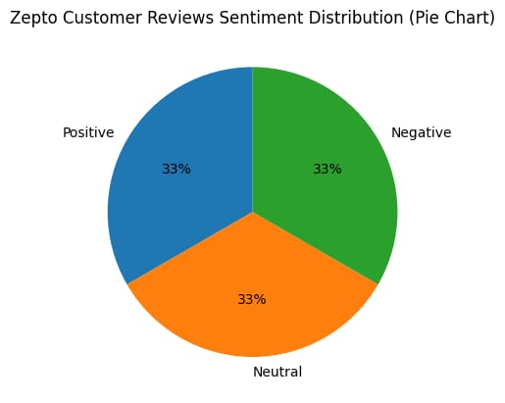
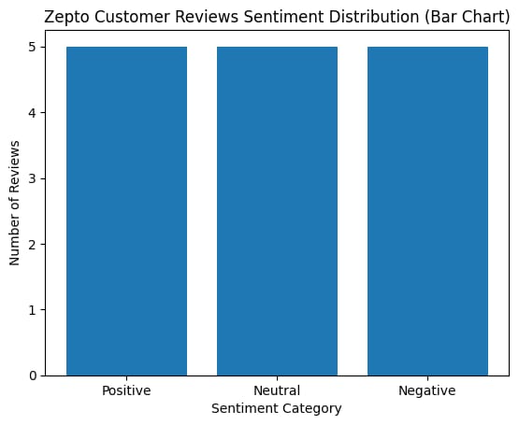

Slide 11
Factor | Zepto | Blinkit | Swiggy Instamart | BigBasket
Delivery Speed | Around 8–10 minutes | About 8–10 minutes | Around 15–30 minutes | Around 10–20 minutes
Product Variety | About 2000+ daily-use items in micro-warehouses. | About 2000+ daily-use items in micro-warehouses. | About 2000+ daily-use items in micro-warehouses. | About 2000+ daily-use items in micro-warehouses.
Pricing | About 2000+ daily-use items in micro-warehouses. | About 2000+ daily-use items in micro-warehouses. | About 2000+ daily-use items in micro-warehouses. | About 2000+ daily-use items in micro-warehouses.
App Experience | About 2000+ daily-use items in micro-warehouses. | About 2000+ daily-use items in micro-warehouses. | About 2000+ daily-use items in micro-warehouses. | About 2000+ daily-use items in micro-warehouses.
Customer Satisfaction | About 2000+ daily-use items in micro-warehouses. | About 2000+ daily-use items in micro-warehouses. | About 2000+ daily-use items in micro-warehouses. | About 2000+ daily-use items in micro-warehouses.

Slide 12
Strengths | Weaknesses | Opportunities | Threats
• Very fast 10-minute delivery 🚀 | • High operational costs | • Expand to more cities | • Competition from Blinkit
• Easy-to-use mobile app 📱 | • Limited service areas | • Add more product categories | • Competition from Swiggy Instamart
• Strong technology and logistics | • Low profit margins | • Competition from BigBasket | • Growing demand for quick delivery

